Slide 1
OOPS 5
ENCPSULATION 2 AND EXCEPTION HANDLING 2
LECTURE 7

Slide 2
STATIC KEYWORD
The static keyword in Java is used for memory management mainly.
We can apply static keyword with variables, methods, blocks and nested classes.
static keyword belongs to the class than an instance of the class.

Slide 3
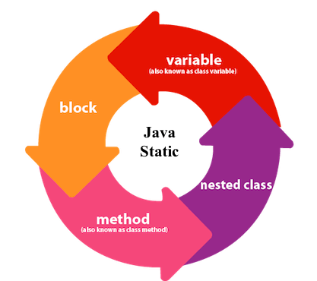
DIAGRAMATIC REPRESENTATION

Slide 4
JAVA STATIC VARIABLE
If you declare any variable as static, it is known as a static variable.
The static variable can be used to refer to the common property of all objects (which is not unique for each object),
for example, the company name of employees, college name of students, etc.
The static variable gets memory only once in the class area at the time of class loading.

Slide 5
SYNTAX
class <class_name>
{
int id;
static String college;
}

Slide 6
ACTIVITY-1
class Student{
int rollno;//instance variable
String name;
static String college ="ITS";//static variable
//constructor
Student(int r, String n){
rollno = r;
name = n;
}
//method to display the values
void display ()
{
System.out.println(rollno+" "+name+" "+college);
}
}

Slide 7
//Test class to show the values of objects
public class TestStaticVariable1{
public static void main(String args[]){
Student s1 = new Student(111,"Karan");
Student s2 = new Student(222,"Aryan");
s1.display();
s2.display();
}
}

Slide 8
OUTPUT
111 Karan ITS
222 Aryan ITS

Slide 9
STATIC METHOD
If you apply static keyword with any method, it is known as static method.
A static method belongs to the class rather than the object of a class.
A static method can be invoked without the need for creating an instance of a class.
A static method can access static data member and can change the value of it.

Slide 10
ACTIVITY-2
class Student{
int rollno;
String name;
static String college = "ITS";
//static method to change the value of static variable
static void change(){
college = "BBDIT";
}
//constructor to initialize the variable
Student(int r, String n){
rollno = r;
name = n;
}

Slide 11
//method to display values
void display(){System.out.println(rollno+" "+name+" "+college);}
}
//Test class to create and display the values of object
public class TestStaticMethod{
public static void main(String args[]){
Student.change();//calling change method
//creating objects
Student s1 = new Student(111,"Karan");
Student s2 = new Student(222,"Aryan");
Student s3 = new Student(333,"Sonoo");
}

Slide 12
//calling display method
s1.display();
s2.display();
s3.display();
}
}

Slide 13
OUTPUT
111 Karan BBDIT
222 Aryan BBDIT
333 Sonoo BBDIT

Slide 14
FINAL KEYWORD
If you make any variable as final, you cannot change the value of final variable(It will be constant).
Example of final variable
There is a final variable speed limit, we are going to change the value of this variable,
but It can't be changed because final variable once assigned a value can never be changed.

Slide 15
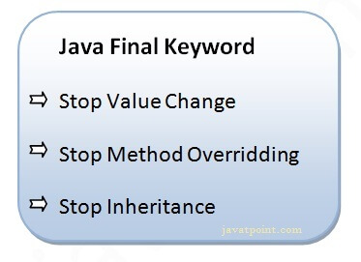
NEED OF FINAL

Slide 16
ACTIVITY-3
class Bike9{
final int speedlimit=90;//final variable
void run(){
speedlimit=400;
}
public static void main(String args[]){
Bike9 obj=new Bike9();
obj.run();
}
}//end of class

Slide 17
OUTPUT
COMPILE TIME ERROR

Slide 18
ACTIVITY-4
class Bike{
final void run(){System.out.println("running");} //FINAL METHOD
}
class Honda extends Bike{
void run(){System.out.println("running safely with 100kmph");}
public static void main(String args[]){
Honda honda= new Honda();
honda.run();
}
}

Slide 19
OUTPUT
COMPILE TIME ERROR

Slide 20
ACTIVITY-5
final class Bike{}
// FINAL CLASS
class Honda1 extends Bike{
void run(){System.out.println("running safely with 100kmph");}
public static void main(String args[]){
Honda1 honda= new Honda1();
honda.run();
}
}
Test it N

Slide 21
OUTPUT
COMPILE TIME ERROR

Slide 22
ACTIVITY-6
Write a java program using static keyword.
Write a java program using final keyword.

Slide 23
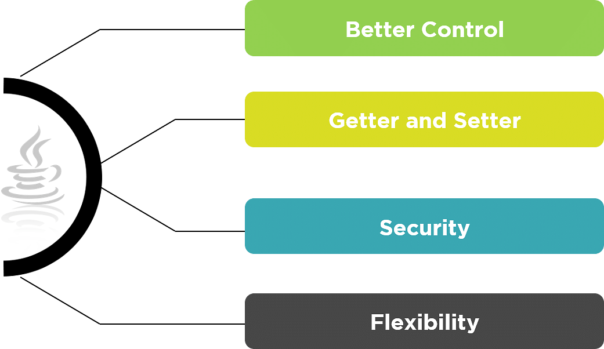
ENCAPSULATION 2

Slide 24
Better Control
Encapsulation provides ultimate control over the data members and data
methods inside the class.
Getter and Setter
The standard IDEs provide in-built support for ‘Getter and Setter’ methods,
which increases the programming pace.

Slide 25
Security
Encapsulation prevents access to data members and data methods by any
external classes.
The encapsulation process improves the security of the encapsulated data.
Flexibility
Changes made to one part of the code can be successfully implemented
without affecting any other part of the code

Slide 26
DATA HIDING VS DATA ENCAPSULATION
Data Hiding | Data Encapsulation
Data hiding can be considered as the parent process | Encapsulation is a sub-process of data hiding
Access specifier is always private | Access specifier can be private and public
Data hiding is about hiding method implementation | Encapsulation is about combining methods with data members
The main motto is to hide data and its implementation | The main motto is to combine data and their methods

Slide 27
HOW TO CODE IN IDE
An IDE, or Integrated Development Environment, is a program which helps you write software.
An IDE helps you organise your software projects, write code, and then test and debug it.
Popular IDEs include Eclipse, IntelliJ and Microsoft Visual Studio.
An IDE usually includes features which help you to:
Write code
Compile or package code
Debug your application

Slide 28
VIDEO LINK
How to run the java code in eclipse IDE?
https://youtu.be/9KtdKyKVY7M

Slide 29
WHAT ARE PACKAGES?
A package in JAVA is a collection of related JAVA entities (like classes,interfaces,exceptions etc.)
This helps us in the following ways:
To organise related classes together.
A class with same name employee from two different companies ABC and XYZ
Can differentiate themselves with different packages prefix.

Slide 30
SYNTAX
package package _name;
Example
package session;
NOTE: Package declaration should be the first statement in the source file.
One class cannot have multiple package declarations.

Slide 31
IMPORT STATEMENT
Using import statement in our program we can instruct the compiler to locate
Our class.
So , instead of writing Full class name we can just write one import
for each class and JAVA will automatically import these classes for us.
Syntax: import package_name.class_name;

Slide 32
EXAMPLE
Single class: import co.trisect.Student;
Multiple classes: import.com.abc.class1;
import.com.xyz.class2;
All classes: import co. trisect.*;
Import statements are written immediately after package declare statements.

Slide 33
IMPORTANT PACKAGES
java.lang : important classes includes String , Object , Exception etc.
java.util: collection framework and other utility classes.
java.io : for input output classes e.g. BufferedReader, BufferedWriter etc.

Slide 34
ACCESS LEVEL MODIFIERS
It help us in controlling the visibility of our class and other members.
There are two levels of access control:
Class level:
public : accessible outside package.
No modifier(default): only inside same package.
Member level:
public: accessible outside package
modifier: only within the same method
private: only within the same class.
protected: within same package and in subclasses.

Slide 35
GETTERS AND SETTERS
The get method returns the variable value,
and the set method sets the value.
Syntax for both is that they start with
either get or set,
followed by the name of the variable,
with the first letter in upper case

Slide 36
ACTIVITY-7
public class Student{
//private data member
private String name;
//getter method for name
public String getName(){
return name;
}
//setter method for name
public void setName(String name){
this.name=name
}
}

Slide 37
//A Java class to test the encapsulated class
class Test{
public static void main(String[] args){
//creating instance of the encapsulated class
Student s=new Student();
//setting value in the name member
s.setName("vijay");
//getting value of the name member
System.out.println(s.getName());
}
}

Slide 38
OUTPUT
vijay

Slide 39
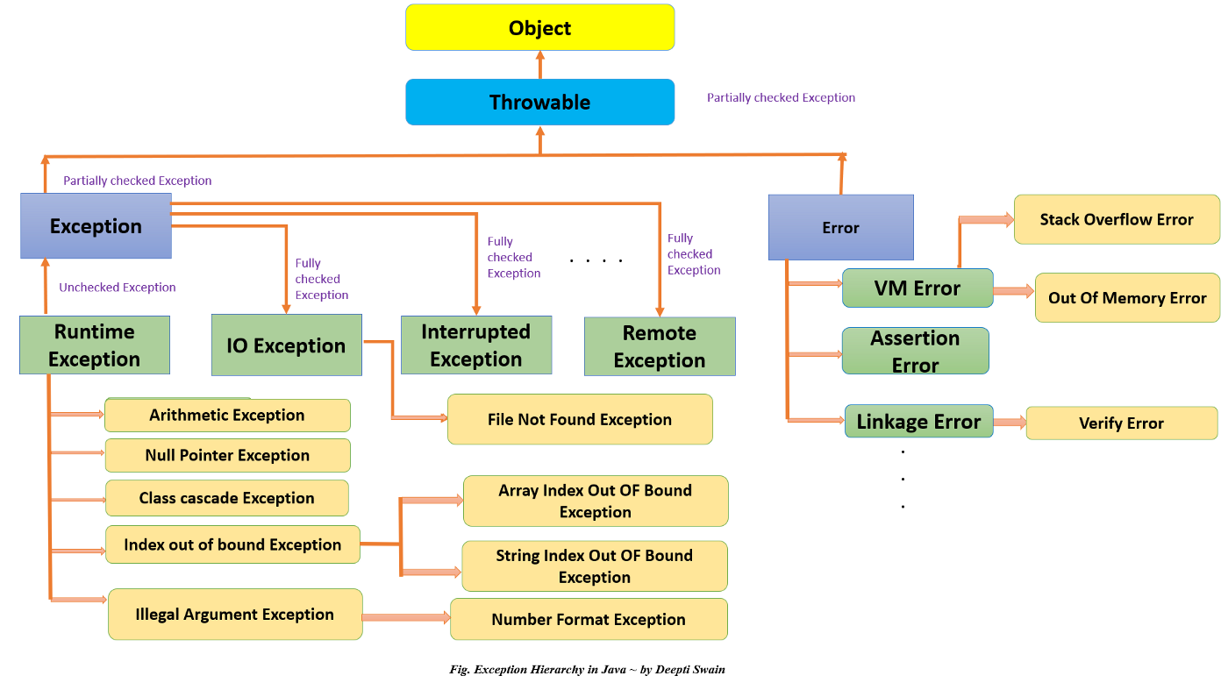
EXCEPTION HANDLING 2

Slide 40
CHECKED VS UNCHECKED EXCEPTION
Checked Exception | Unchecked Exception
They are known and are checked at compile time. | They are known at runtime and hence are not checked at compile time.
If these exceptions are not handled properly in the application, they give compile time error. | Checked exceptions are known to compiler whereas unchecked exceptions are not known to compiler because they occur at runtime.
All subclasses of Exception class except subclasses of Runtime Exception are checked Exception | All subclasses of Runtime Exception and subclasses of error are unchecked exceptions.
Example: SQLException ,IOException,FilenotFoundException | Example: StackOverFlowError, OutOfMemoryError

Slide 41
THROW AND THROWS KEYWORD
Sr. no. | Basis of Differences | throw | throws
1. | Definition | Java throw keyword is used throw an exception explicitly in the code, inside the function or the block of code. | Java throws keyword is used in the method signature to declare an exception which might be thrown by the function while the execution of the code.
2. |  | .Type of exception Using throw keyword, we can only propagate unchecked exception i.e., the checked exception cannot be propagated using throw only. | Using throws keyword, we can declare both checked and unchecked exceptions. However, the throws keyword can be used to propagate checked exceptions only
3. | Syntax | The throw keyword is followed by an instance of Exception to be thrown. | The throws keyword is followed by class names of Exceptions to be thrown.
4. | Declaration | throw is used within the method. | throws is used with the method signature.
5. | Internal implementation | We are allowed to throw only one exception at a time i.e. we cannot throw multiple exceptions. | We can declare multiple exceptions using throws keyword that can be thrown by the method. For example, main() throws IOException,

Slide 42
Main difference
throw | throws
Used to throw an exception for a method | Used to indicate what exception type may be thrown by a method
Cannot throw multiple exceptions | Can declare multiple exceptions
Syntax:throw is followed by an object (new type) used inside the method | Syntax: throws is followed by a class and used with the method signature

Slide 43
Important points to remember about throws keyword:
throws keyword is required only for checked exception and usage of throws
keyword for unchecked exception is meaningless.
throws keyword is required only to convince compiler and usage of throws
keyword does not prevent abnormal termination of program.
By the help of throws keyword we can provide information to the caller of the
method about the exception.

Slide 44
ACTIVITY-8
class ThrowsExecp
{
static void fun() throws IllegalAccessException
{
System. out.println("Inside fun(). ");
throw new IllegalAccessException("demo");
}
public static void main(String args[])
{
try
{
fun();
}
catch(IllegalAccessException e)
{
System.out.println("caught in main.");
}
}
}

Slide 45
OUTPUT
Inside fun().
caught in main.

Slide 46
IMPORTANT POINTS ABOUT THROW
The throw keyword is used to explicitly throw a single exception.
When an exception is thrown, the flow of program execution transfers from the try block to the catch block.
We use the throw keyword within a method.

Slide 47
ACTIVITY-9
public class TestThrow {
//defining a method
public static void checkNum(int num) {
if (num < 1) {
throw new ArithmeticException("\nNumber is negative, cannot calculate square");
}
else {
System.out.println("Square of " + num + " is " + (num*num));
}
}

Slide 48
//main method
public static void main(String[] args) {
TestThrow obj = new TestThrow();
obj.checkNum(-3);
System.out.println("Rest of the code..");
}

Slide 49
OUTPUT
Number is negative ,cannot calculate square.

Slide 50
CUSTOM EXCEPTION
In Java, we can create our own exceptions that are derived classes of the Exception class.
Creating our own Exception is known as custom exception or user-defined exception.
Basically, Java custom exceptions are used to customize the exception according to user need.

Slide 51
EXAMPLE
public class WrongFileNameException extends Exception {
public WrongFileNameException(String errorMessage) {
super(errorMessage);
}
}
Note: We need to write the constructor that takes the String as the error message and it is called parent class constructor.

Slide 52
ACTIVITY-10
// class representing custom exception
class InvalidAgeException extends Exception
{
public InvalidAgeException (String str)
{
// calling the constructor of parent Exception
super(str);
}
}

Slide 53
// class that uses custom exception InvalidAgeException
public class TestCustomException1
{
// method to check the age
static void validate (int age) throws InvalidAgeException{
if(age < 18){
// throw an object of user defined exception
throw new InvalidAgeException("age is not valid to vote");
}

Slide 54
else {
System.out.println("welcome to vote");
}
}
// main method
public static void main(String args[])
{
try
{
// calling the method
validate(13);
}

Slide 55
catch (InvalidAgeException ex)
{
System.out.println("Caught the exception");
// printing the message from InvalidAgeException object
System.out.println("Exception occurred: " + ex);
}
System.out.println("rest of the code...");
}
}

Slide 56
OUTPUT
Caught the exception
Exception occurred: InvalidAgeException: age is not valid to vote.
rest of the code….

Slide 57
ASSIGNMENT
Write a java program using throw and throws keyword.
Write a java program using static and final keyword.
Give differences between these two programs.
Write a java program for custom exceptions.

Slide 58
Interview Questions
Explain the exception hierarchy.
Explain the difference between –Error and Exception.
Explain the checked and unchecked exceptions with examples.
Explain the usage of throw and throws keyword with examples.
What are packages ? How can we use them avoid name collisions.
Write the import statement for: HashSet.
Can we declare a constructor private ? Explain your answer.
Explain protected modifier.

Slide 59
Answers
For answers refer J10C1 sheet.

Slide 60
THANKYOU

